Slide 1
GridLAB-D Turorial – Session 2
Powerflow Module
David P. Chassin
Summer 2016
dchassin@slac.stanford.edu
All registered trademarks are hereby recognized.

Slide 2
Powerflow Overview
Powerflow: fundamental power system analysis tool.
Problem statement: “For any system, given the voltages of the generators, the characteristics of power lines, and the voltage response of loads, determine the voltage magnitudes and angles at all nodes on the system.”
Solution allows for the calculation of derived quantities
All line currents
All power flows throughout the system

Slide 3
Powerflow Overview
Transmission Systems
Originally limited to transmission systems
Many assumptions made in early flow solvers, e.g.,
Positive sequence phase model
Polynomial load response to voltage
Distribution Systems
Stability & voltage sag wasn’t a problem → powerflow not done
Initially based on simple circuit equivalents
Sequential components used but found inappropriate.
Recent work has focused on more complete modeling
Full unbalanced 3-phase models are now the standard
Composite load model is becoming more prevalent
Distributed generation and voltage control a growing problem

Slide 4
Distribution System Modeling
Traditionally analysis performed for transmission
Distribution analysis growing in last 20 years
Emerging technologies designed to operate in distribution
Distribution modeling similar to transmission modeling
More detail in equipment models
Single and double phase lines exist
Distribution systems are often radial
The R/X values in distribution are much higher
Loads are unbalanced

Slide 5
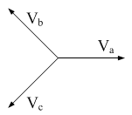
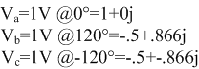
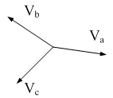
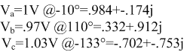
What Does “Unbalanced” Mean?
The voltage at the source is balanced:
The voltages downstream are unbalanced:

Slide 6
Types of Distribution System Equipment
Very common in distribution systems:
Overhead lines
Underground cables
Transformers
Voltage regulators
Shunt capacitors
Others that may be found:
Switches
Reclosers
Fuses
Lightning protection

Slide 7
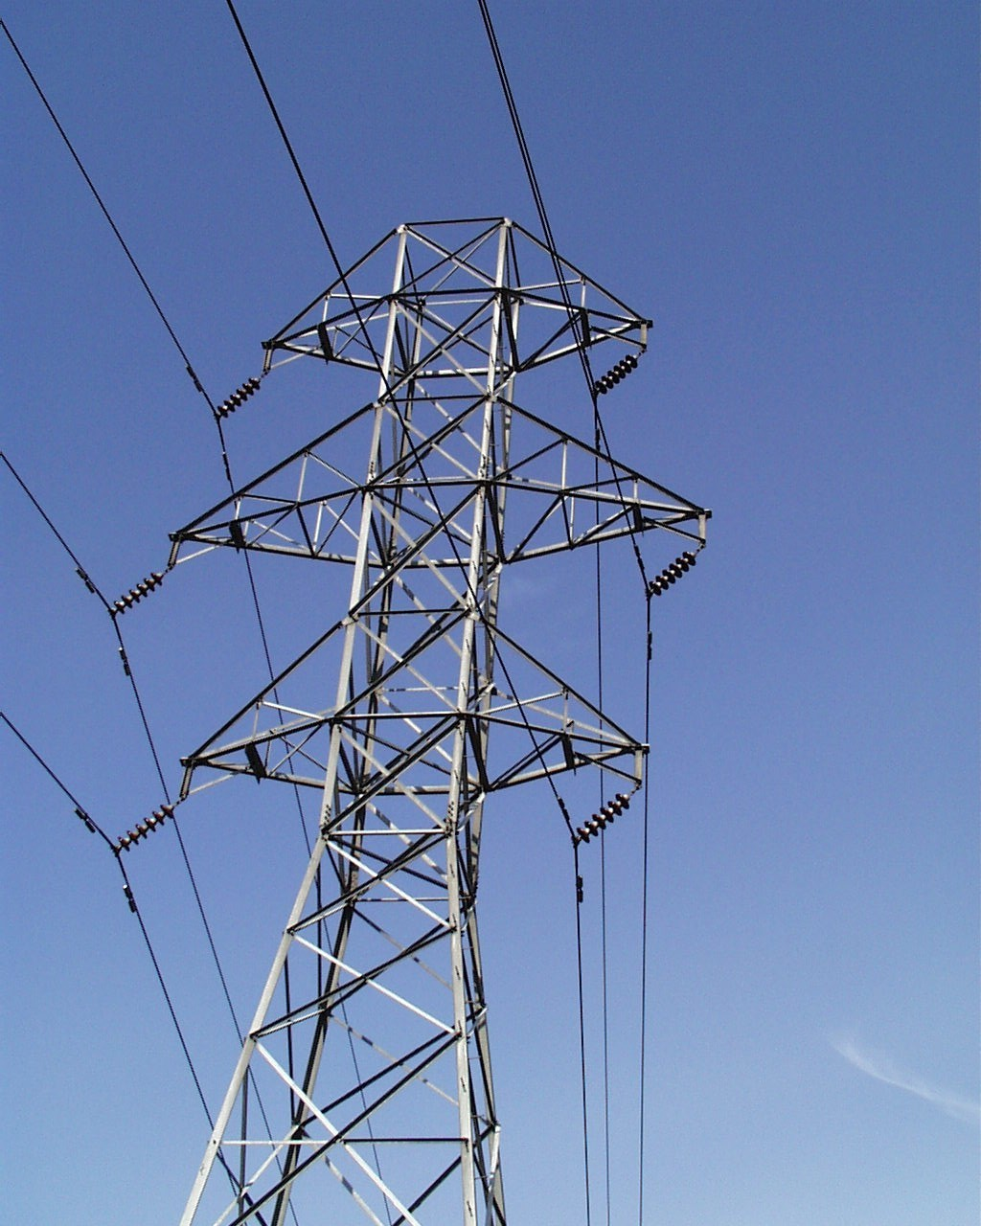
Transmission System

Slide 8
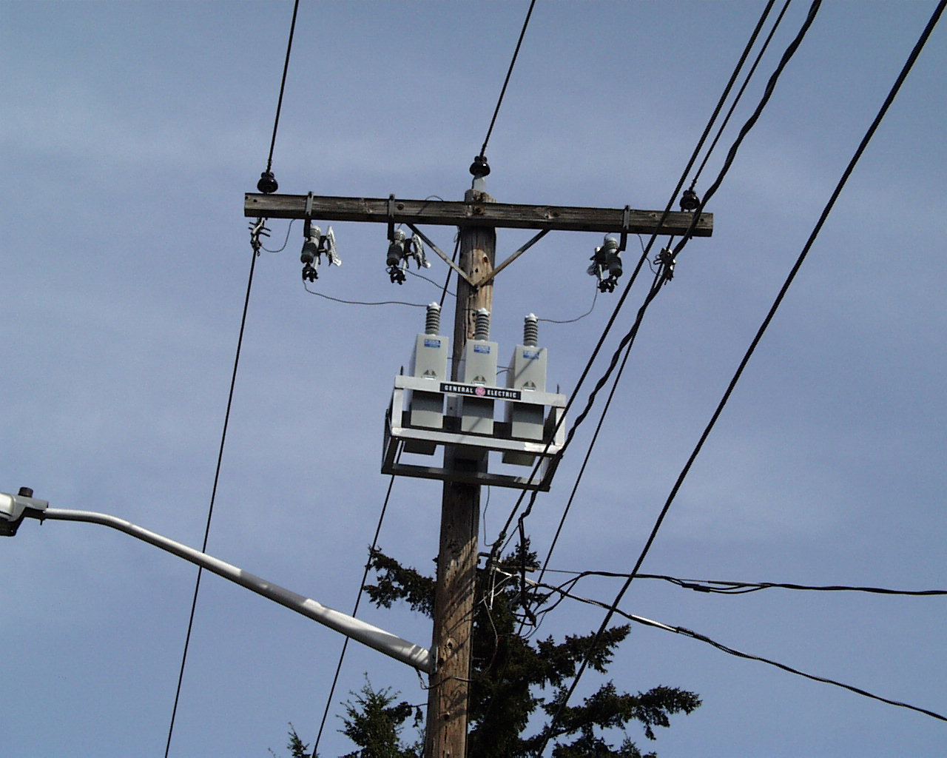
Distribution System

Slide 9
System Representations
Positive Sequence Model
Three-phase Model
Assumed 3-phase balanced
Single-phase equivalent models are used
Performance advantage
Limits accuracy of model
No phase-specific behavior
Each phase explicit
Model includes neutral
Electromagnetic coupling
Allows accurate modeling
Partial phase line topology
Split-phase segments
Single-phase loads
Two-phase loads
Phase-specific measurement, control design and actuation

Slide 10
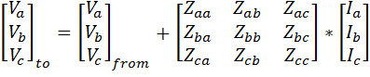
Modeling comparisons
Positive Sequence
Unbalanced
+
-

Slide 11

Three-phase Unbalanced
a
2.5'
b
4.5'
c
3.0'
4.0'
n
24.0'
Phase Conductor: 336,400 26/7
GMR = 0.0244 ft., Resistance = 0.306 Ω/mile, Diameter = 0.721 inch
Neutral Conductor: 4/0 6/1 ACSR
GMR = 0.00814 ft., Resistance = 0.592 Ω/mile, Diameter = 0.563 inch
Physical System
Parameterized Values
Values for Numeric Simulation

Slide 12
Overhead Line Code
Object Code
Configuration Code
object overhead_line {
phases "BCN";
name ohl_632-645;
from node_632;
to load_645;
length 500 ft;
configuration line_config_603;
}
object line_configuration {
name line_config_603;
conductor_B ohl_conductor_6030;
conductor_C ohl_conductor_6030;
conductor_N ohl_conductor_6030;
spacing line_spacing_505603;
}
// Phase Conductor for 603, 604, 605: 1/0 ACSR
object overhead_line_conductor {
name ohl_conductor_6030;
geometric_mean_radius 0.004460;
resistance 1.120000;
}
object line_spacing {
name line_spacing_505603;
distance_BC 7.0 ft;
distance_CN 5.657 ft;
distance_BN 5.0 ft;
}
B
C
N

Slide 13
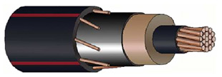
Underground Cables
Power conductors
Ground conductors

Slide 14
Underground Cable Code
Object Code
Configuration Code
object underground_line {
phases "AN";
name ugl684_652;
from node_684;
to load_652;
length 800;
configuration line_config_607;
}
object line_configuration {
name line_config_607;
conductor_A ugl_conductor_6070;
conductor_N ugl_conductor_6070;
spacing line_spacing_520;
}
// Phase Conductor for 607: 1/0 AA,TS N: 1/0 Cu
object underground_line_conductor {
name ugl_conductor_6070;
outer_diameter 1.060000;
conductor_gmr 0.011100;
conductor_diameter 0.368000;
conductor_resistance 0.970000;
neutral_gmr 0.011100;
neutral_resistance 0.970000;
neutral_diameter 0.0640837;
neutral_strands 6.000000;
shield_gmr 0.000000;
shield_resistance 0.000000;
}
object line_spacing {
name line_spacing_520;
distance_AN 0.0833 ft;
}

Slide 15
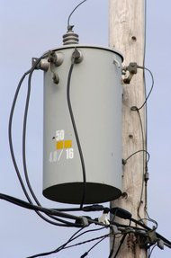
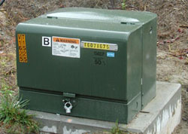
Service Transformers
Poletop
Padmount
Underground Vault

Slide 16
Service Transformer Model
120V
7,200V
240V
120V

Slide 17
Transformer Code
Object Code
Configuration Code
object transformer {
groupid Distribution_Trans;
configuration tc100100B;
name f5_T21400253B;
from f5_L2691959;
to f5_X2691959B;
nominal_voltage 7200;
phases BS;
}
object transformer_configuration {
name tc100100B;
connect_type SINGLE_PHASE_CENTER_TAPPED;
install_type POLETOP;
primary_voltage 7200.0;
secondary_voltage 120.0;
power_rating 100.0;
powerB_rating 100.0;
impedance 0.006+0.0136j;
// Only used in Wye-Wye and CTTF
impedance1 0.012+0.0204j;
impedance2 0.012+0.0204j;
shunt_impedance 259200+103680j;
}

Slide 18
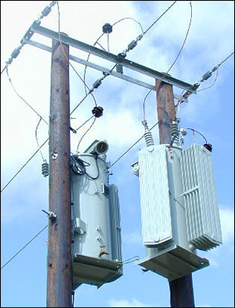
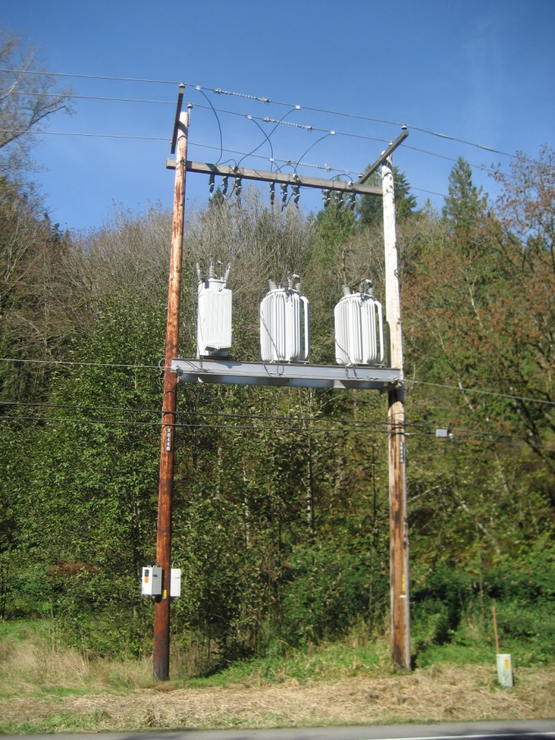
Voltage Regulators
Voltage regulators adjust the voltage on a branch
Compensates for heavy (or light) loading
Controls voltage drop (or rise) that results from load changes

Slide 19
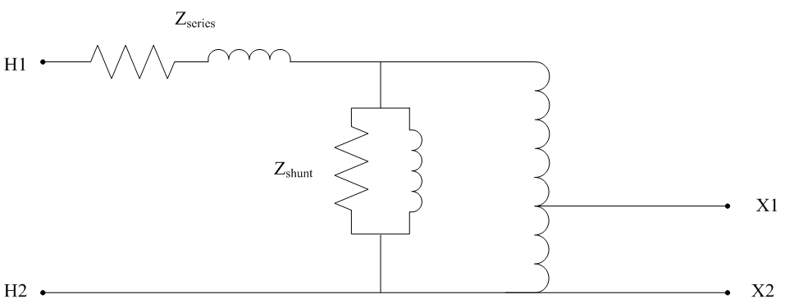
Voltage Regulators
Two winding auto transformers with a variable tap ratio
Note: GridLAB-D represents voltage regulators as ideal transformers (no losses)

Slide 20
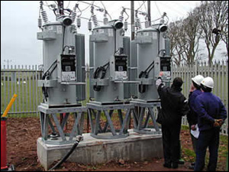
Voltage Regulator Code
Object Code
Configuration Code
object regulator {
name reg1501491;
phases "ABC";
from node_150;
to node_1491;
configuration regulator_config_15;
}
object regulator_configuration {
name regulator_config_15;
connect_type WYE_WYE;
band_center 120.000;
band_width 2.0;
time_delay 30.0;
raise_taps 16;
lower_taps 16;
current_transducer_ratio 700;
power_transducer_ratio 20;
compensator_r_setting_A 3.0;
compensator_x_setting_A 7.5;
compensator_r_setting_B 3.0;
compensator_x_setting_B 7.5;
compensator_r_setting_C 3.0;
compensator_x_setting_C 7.5;
CT_phase "ABC";
PT_phase "ABC";
regulation 0.10;
Type A;
tap_pos_A 7;
tap_pos_B 7;
tap_pos_C 7;
Control MANUAL; // OUTPUT_VOLTAGE, // LINE_DROP_COMP or REMOTE NODE
}

Slide 21
Shunt Capacitors

Slide 22
Capacitor Code
Object Code
object capacitor {
phases ABCN;
name CAP1;
pt_phase ABCN;
parent 675;
phases_connected ABCN;
control VOLT;
voltage_set_high 2700.0;
voltage_set_low 2250.0;
capacitor_A 0.10 MVAr;
capacitor_B 0.10 MVAr;
capacitor_C 0.10 MVAr;
control_level INDIVIDUAL;
time_delay 300.0;
dwell_time 0.0;
switchA CLOSED;
switchB CLOSED;
switchC CLOSED;
nominal_voltage 2401.7771;
}
Control modes available: MANUAL, VOLT, VAR, VARVOLT and CURRENT
pt_phase determines the phases to monitor for controls
nominal_voltage determines the impedance value
control_level may also be BANK
lockout_time allows minimum time between control operations
remote_sense/remote_sense_B may be used for remote sensing operations

Slide 23
End Use Load Modeling
End use loads can be modeled in a variety of ways depending on the purpose.
Time-invariant load models (ZIP models)
Time-variant load models
Physical/performance load models (motor/power electronics)
Multi-state/control response load models
Dynamic response models (Deltamode)
Note: Most of the loads in GridLAB-D are represented in the residential module, but the basic theory is described here.

Slide 24
Time-invariant load models
Used for static power flow solution
Used for capacity planning: peak load is examined
Traditional ZIP load model

Slide 25
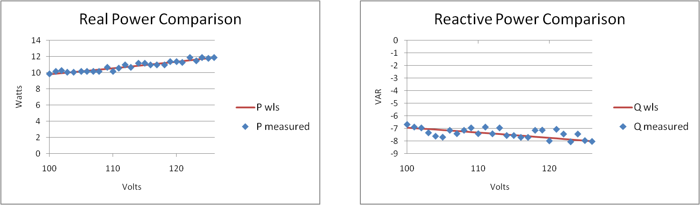
ZIP Load Model for 13W CFL
 | ZIP Values
 | Z_% | I_% | P_% | Z_pf | I_pf | P_pf
CFL-13W | 40.85% | 0.67% | 58.49% | -0.88 | 0.42 | -0.78

Slide 26
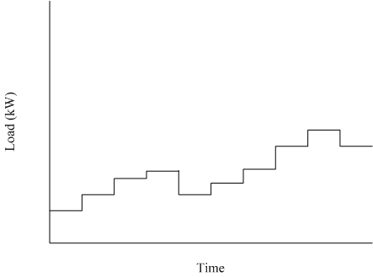
Time-variant load models
Often referred to as load profiles or load shapes
Can be power or ZIP values that change with time
Often comes from measured data with aggregated value

Slide 27
ZIP Load Code
Object Code
Schedule Code
object ZIPload {
groupid plugload;
base_power plug1*2.828958;
power_fraction 0.100000;
impedance_fraction 0.800000;
current_fraction 0.100000;
power_pf 0.950000;
current_pf 0.950000;
impedance_pf 0.950000;
};
schedule plug1 {
0-23 0 * * * 0.1605;
24-59 0 * * * 0.1381;
0-30 1 * * * 0.1297;
31-59 1 * * * 0.1289;
0-34 2 * * * 0.1254;
35-59 2 * * * 0.1301;
0-29 3 * * * 0.1255;
30-59 3 * * * 0.1276;
0-18 4 * * * 0.1292;
19-44 4 * * * 0.1399;
45-59 4 * * * 0.1422;
0-14 5 * * * 0.1438;
15-35 5 * * * 0.1621;
36-59 5 * * * 0.1806;
0-14 6 * * * 0.1981;
...
}

Slide 28
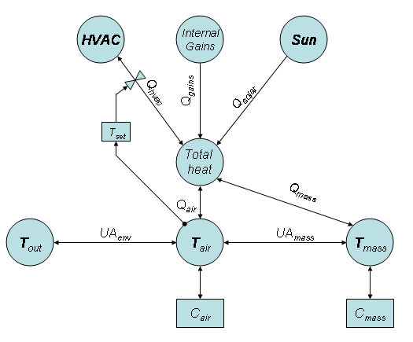
Physical Load Models
Load models based on physical process
HVAC, energy storage, thermal processes, etc.
Usually time-variant model
Can be significantly more complicated than ZIP models
Usually cannot be modeled using a single LTI model
Provide detail necessary to consider actual load behavior

Slide 29
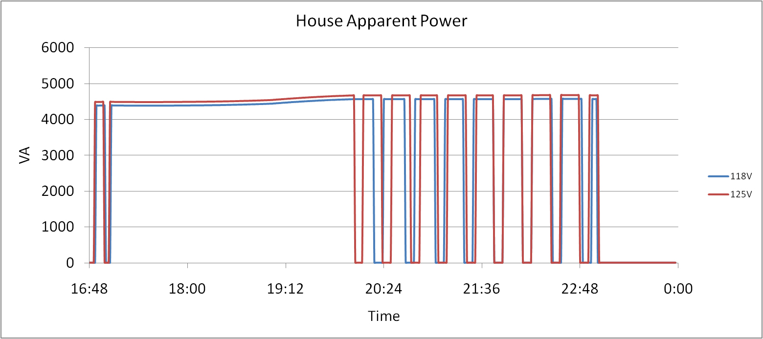
Physical Load Model – Residential HVAC

Slide 30
Multi-State Physical Load Models
Allow for more than one state of operation
Usually requires a control system to govern state dynamics
Almost always results in non-LTI model
Necessary for modern appliances & demand response
HVAC systems are a good example:
State 1: Off
State 2: Cooling
State 3: Heating
State 4: Auxiliary Heating

Slide 31
Multi-State Physical Load Models
From State | To State | Transition Rule
1 | 2 | T_{air} > (T_{high} + DB_{high})
1 | 3 | T_{air} < (T_{low} – DB_{low})
1 | 4 | T_{air} < (T_{low} – DB_{low}) & T_{out} < T_{aux}
2 | 1 | T_{air} < (T_{high} – DB_{high})
3 | 1 | T_{air} > (T_{low} + DB_{low})
3 | 4 | T_{out} < T_{aux}
4 | 1 | T_{air} > (T_{low} + DB_{low})

Slide 32
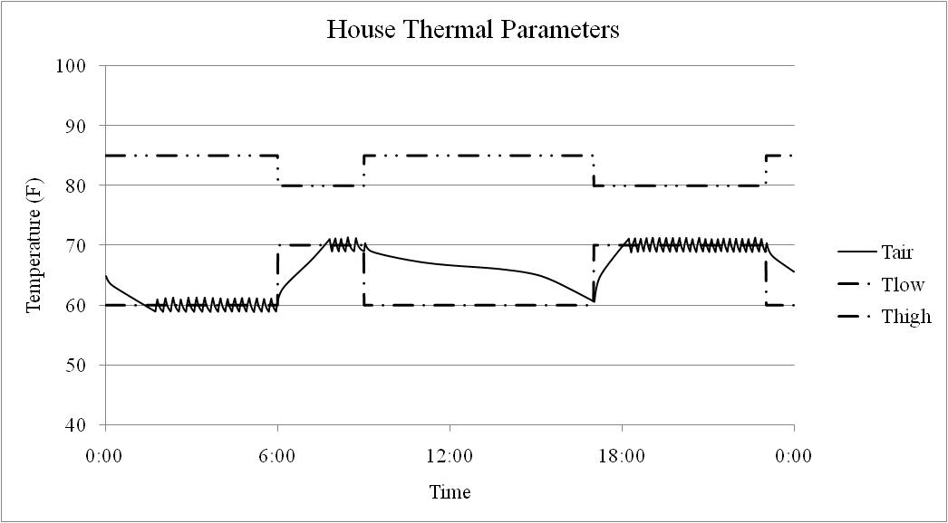
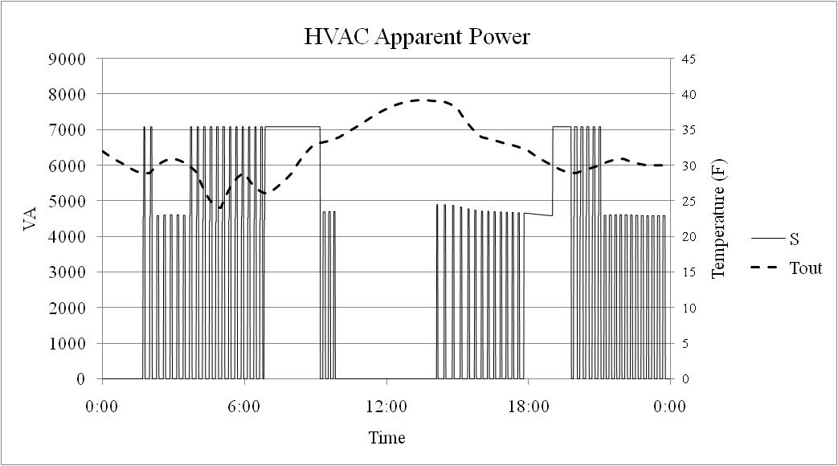
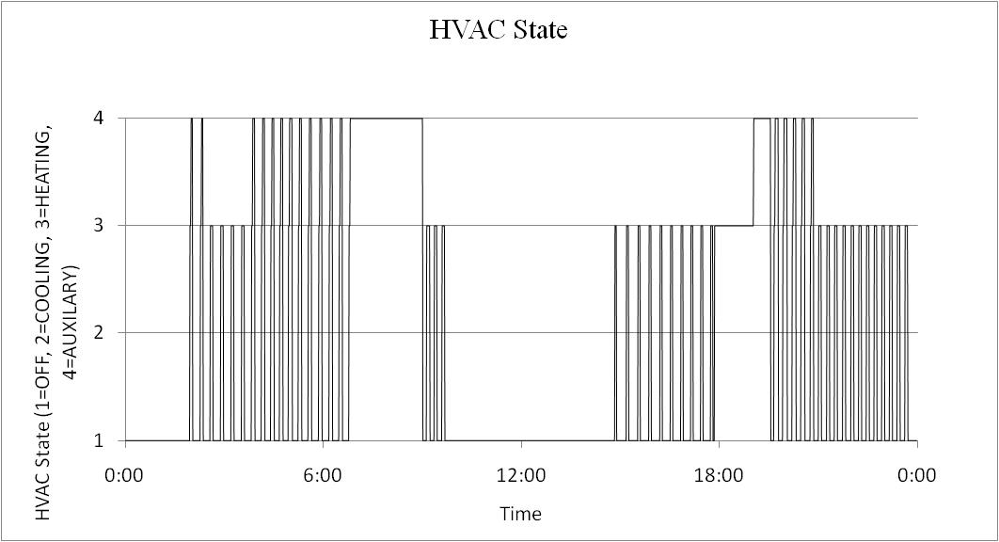
Multi-State Physical Load Models

Slide 33
Distribution System
Power Flow Solution Methods
Given the source voltage and end use load, determine the voltage magnitude and angle at every node in the system.

Slide 34
Two methods available
Forward/Backward Sweep method
Fast, efficient, and robust to initial conditions
Cannot solve meshed systems
Reference:
W. H. Kersting, “Distribution System Modeling and Analysis, 2nd Edition”, CRC Press, 2007.
Newton-Raphson Method
Can solve meshed systems
Requires Jacobian
Fast converges for good initial values, otherwise, may fail to converge
References:
P. A. N. Garcia, J. L. R. Pereira, S. Carneiro Jr., V. M. Da Costa, and N. Martins, “Three-Phase Power Flow Calculations using the Current Injection Method”, IEEE Transaction on Power Systems, vol. 15, issue 4, pp. 508-514, May 2000.
Araujo, L.R.; Penido, D.R.R.; Carneiro, S.; Pereira, J.L.R.; Garcia, P.A.N., “A Comparative Study on the Performance of TCIM Full Newton versus Backward-Forward Power Flow Methods for Large Distribution Systems”, in Proc. 2006 IEEE PES Power Systems Conference and Exposition, pp. 522-526.

Slide 35
Forward/Backward Sweep (FBS) method
FBS method also called ladder solver
Among earliest methods used for unbalanced power flow.
Very efficient algorithm for radial systems
Cannot solve looped systems
Some components may make system appear non-radial
Backflows from DG are allowed
Lateral switching may reverse currents
Overall very good solution method, but has known limitations
Deltamode and reliability modules don’t support FBS solver

Slide 36
Forward/Backward Sweep Example

Slide 37
Backward Sweep
Starting with an assumed or known voltage and calculate the current to each load in the system
Node 634 load:
Phase a: 160 kW; 110 kVar
Phase b: 120 kW; 90 kVar
Phase c: 120 kW; 90 kVar
Assume:
Phase V_{a}: +2401 +0j
Phase V_{b}: -1200 -2080j
Phase V_{c}: -1200 +2080j
Given: I=(S/V)*
Yields:
I_{a}= +66.6 -45.8j
I_{b}= -57.4 -24.6j
I_{c}= +7.5 +62.0j

Slide 38
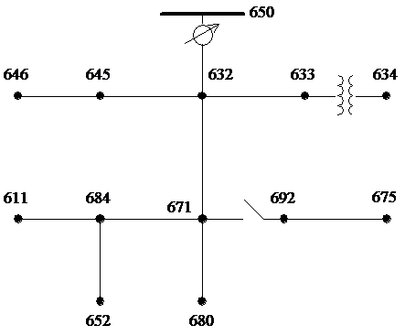
Backward Sweep
Sum the currents at each node in the system until the current at the source is determined.
I_{a}= +66.6 -45.8j
I_{b}= -57.4 -24.6j
I_{c}= +7.5 +62.0j

Slide 39
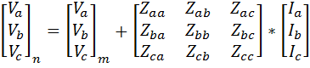
Forward Sweep
Use currents to determine voltage drops on segments
Voltage drop depends on load of other phases → complete per phase calculation must be used

Slide 40
Recalculate Load
Recalculate new current draw using new voltages for each load and perform another sweep

Slide 41
Newton-Raphson Method
Developed for positive sequence transmission analysis
Adapted for 3-phase unbalanced distribution analysis
Based on the real/reactive power injections at each node
Power injections used to update voltage magnitude and angle
Requires the calculation and inversion of a Jacobian
Computationally intensive
GridLAB-D implementation features
Automatically constructs/updates Jacobian from models
Uses previous results as initial condition → fast convergence

Slide 42
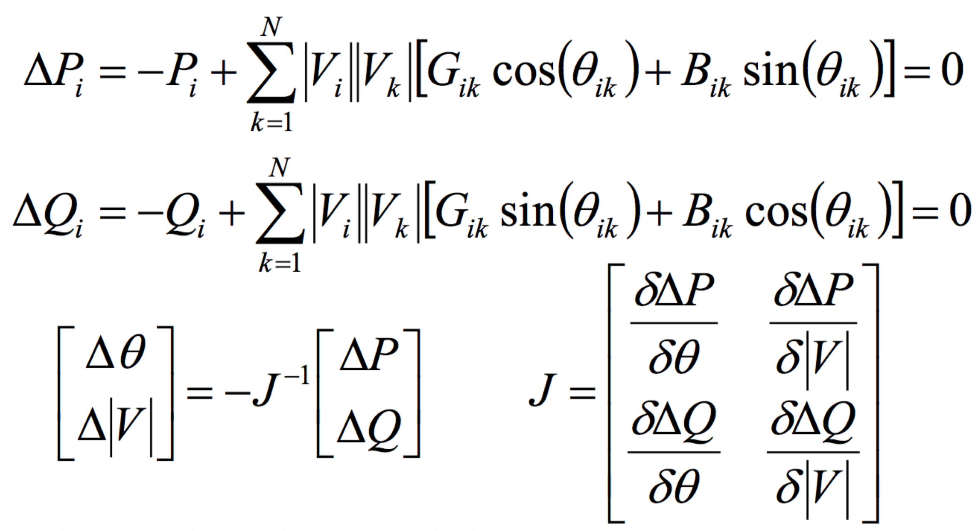
Newton-Raphson Method
P_{i} the real power injection at node i
Q_{i} the reactive power injection at node i
G_{ik} real portion of the admittance between node i and k
B_{ik} imaginary portion of the admittance between node i and k
V_{i} the voltage magnitude at node i
δ_{i} the voltage angle at node i

Slide 43
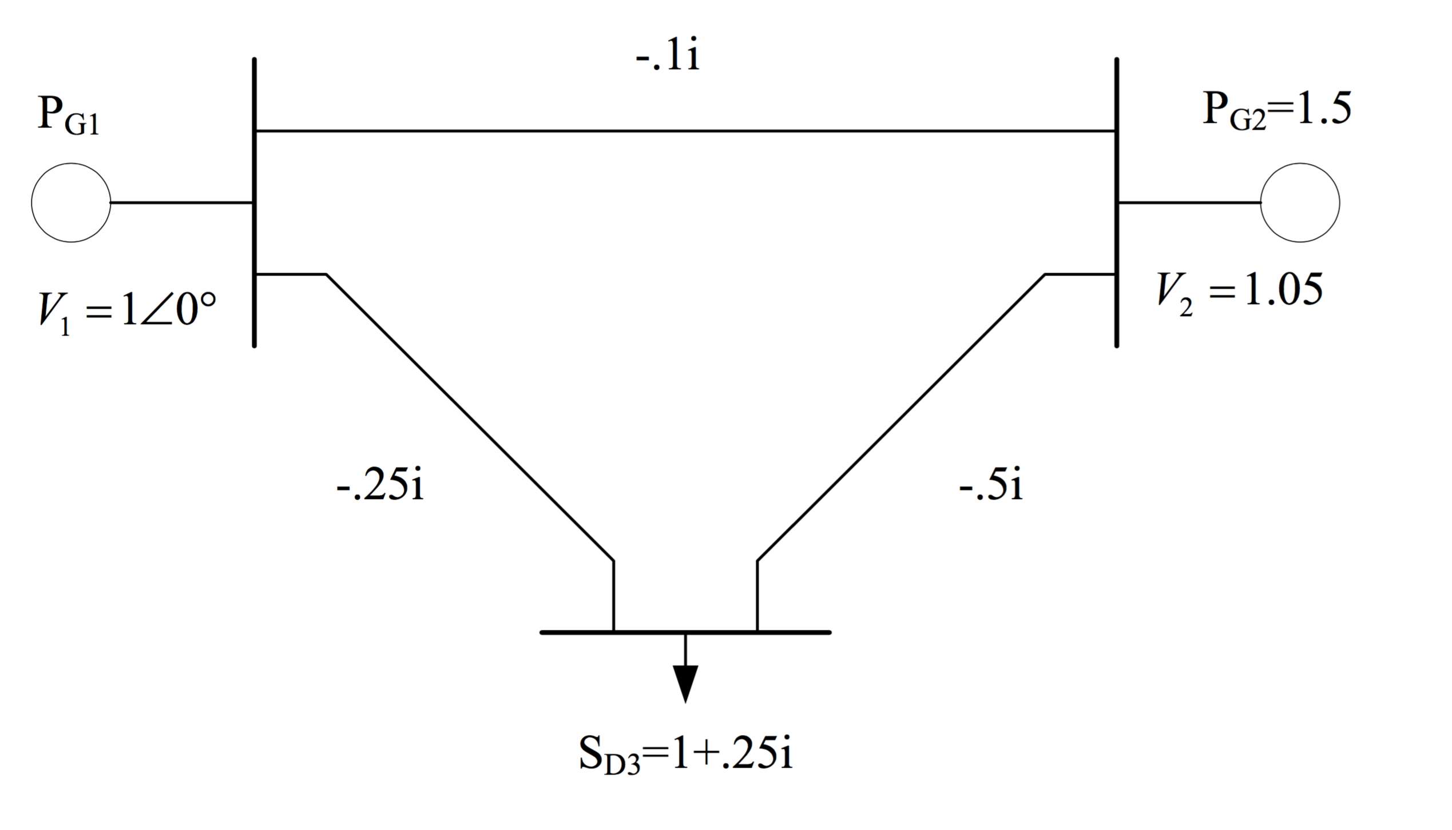
Newton-Raphson Example (Transmission Level Example)

Slide 44
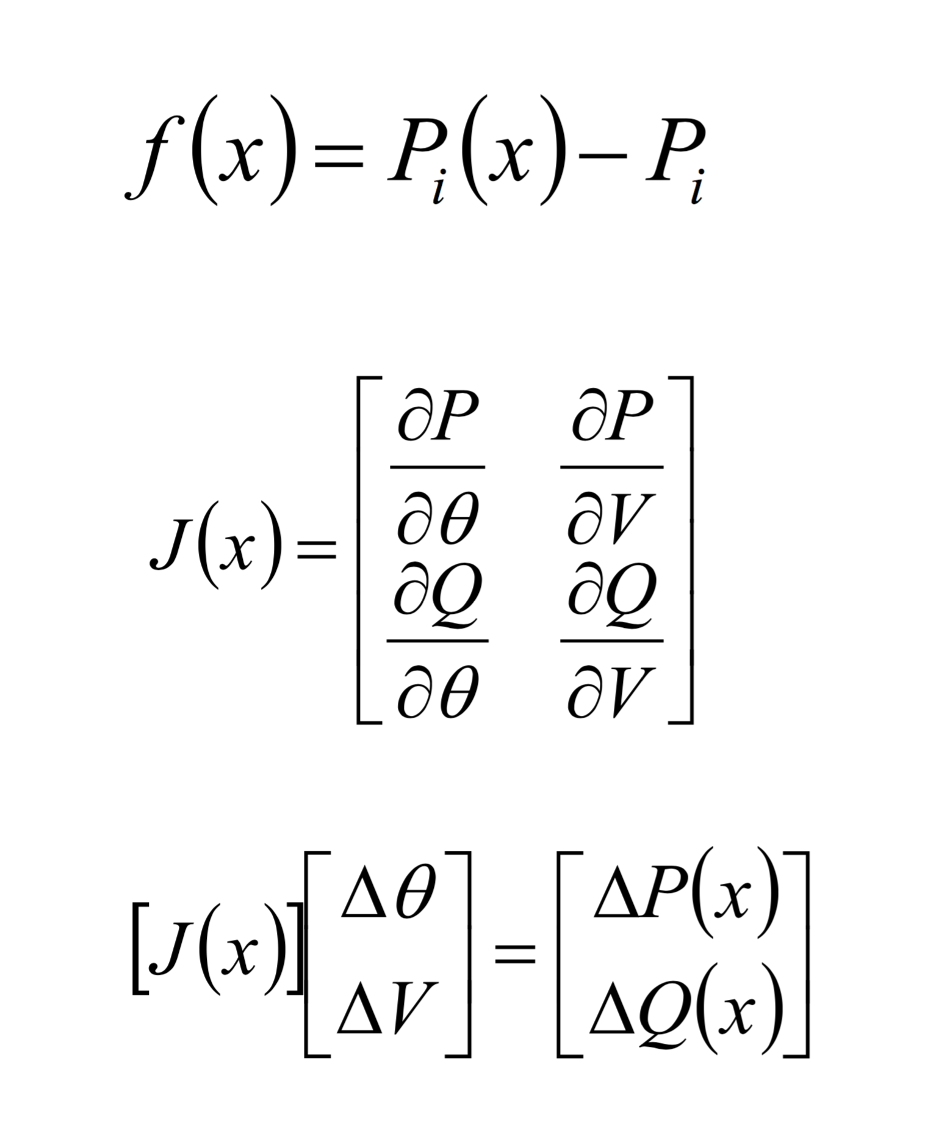
Newton Raphson Procedure

Slide 45
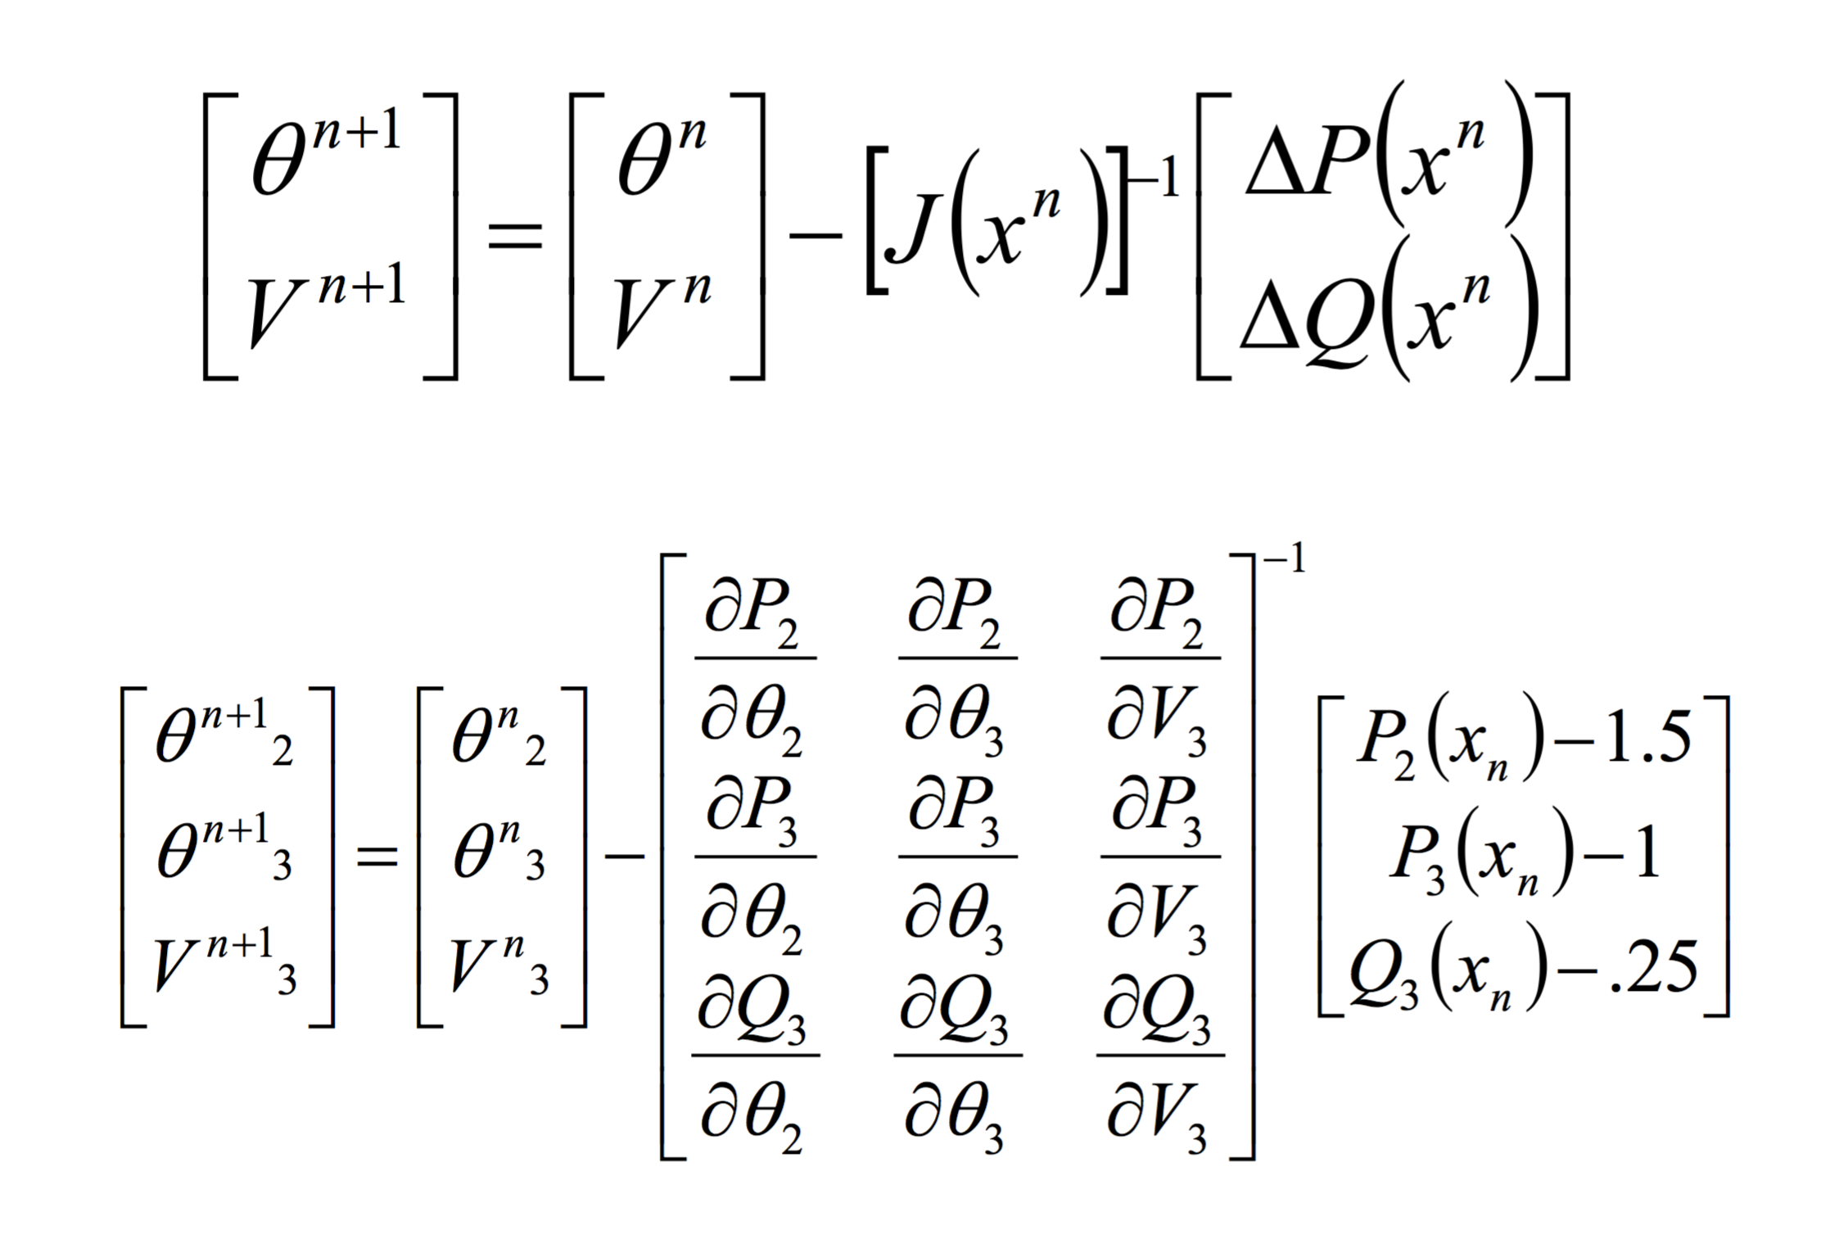
Newton Raphson Procedure

Slide 46
N-R Power Flow Results

Slide 47
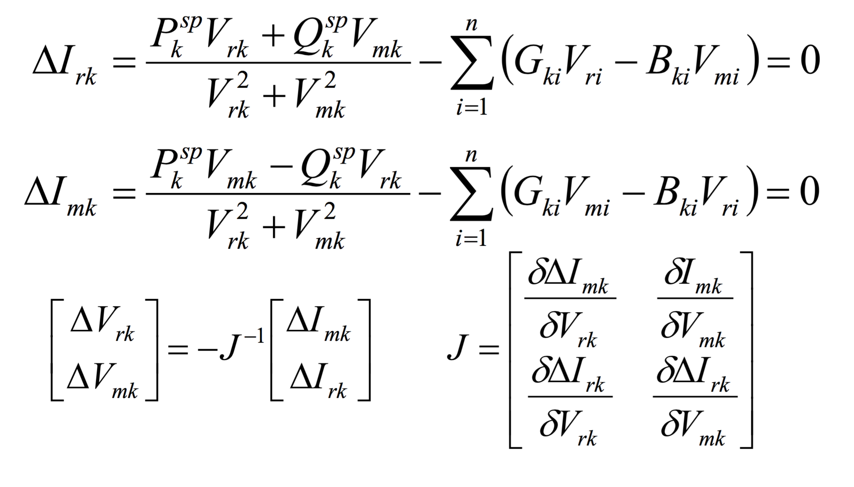
Newton-Raphson Method (TCIM)
Instead of voltage magnitudes and angles, TCIM calculates the real and reactive components
Voltage magnitudes and angle are then calculated from the components

Slide 48
Time-series Simulations
Time series simulations necessary for certain analyses
Allows focus on “non-peak capacity” conditions
Simulations are series of steady-state power flow solutions
Commonly called “quasi-steady” simulation
Differ from dynamic or electromagnetic simulations
State (x)
Δx
Δt
Time (t)

Slide 49
Modified IEEE 13 Node Test System

Slide 50
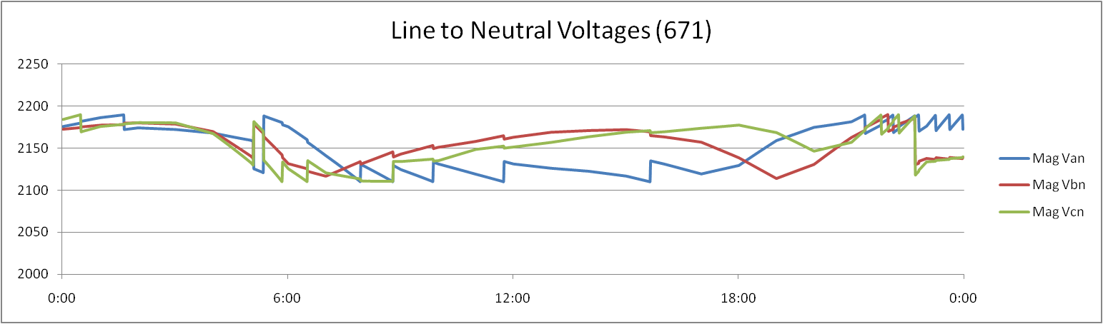
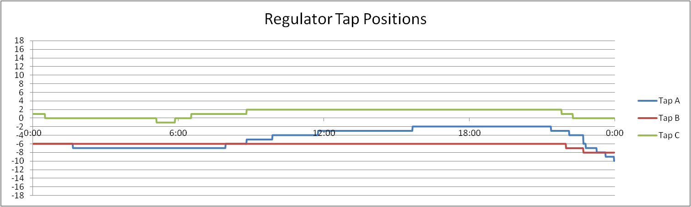
Time-series Simulations (II)

Slide 51
How does it work?
Distribution system handled as network (nodes & links)
Forward-Backward Sweep (FBS)
Voltage (nodes) and current (links) passed in sweeps
Sweeps repeated each time step until zero voltage “error”
Newton-Raphson (NR)
Admittance matrix built from links
Used to calculate node voltages given current injections
Iterations performed by SuperLU until zero voltage “error”
Iterations by GridLAB-D handles control algorithms

Slide 52
Powerflow module directives
Preferred method depends on application
As implemented, FBS is faster
As implemented, NR handles meshed systems, reconfiguration algorithms, and reliability
Both methods support all objects in all other modules
Exceptions for FBS:
Reconfiguration, reliability, and deltamode (dynamics).
module powerflow {
solver_method FBS; // or NR; GS is deprecated as V3.0
default_maximum_voltage_error 1e-6; // defines convergence criteria
NR_iteration_limit 50; // max SuperLU iterations per GLD iteration
NR_superLU_procs 1; // max processors assigned to SuperLU
}

Slide 53
Objects in Powerflow Module
Two main object types: node and link
Most powerflow objects inherit properties from node and link
Library objects
Specify configurations that are used multiple times
line_configuration
line_spacing
transformer_configuration
regulator_configuration
Provide “library” values to compute model parameters
Not used directly in constructing solutions

Slide 54
Abstract node and link objects
FBS calculation done at level of node and link objects
Node Objects
Link Objects
Capacitor
Load
Meter/triplex_meter
PQLoad
Substation
Billdump
Voltdump
Motor (experimental)
Frequency_gen
Volt_var_control
Currdump
Emissions
Fuse
Switch_object
Relay
Recloser
Sectionalizer
Overhead_line
Underground_line
Triplex_line
Series_reactor
Regulator
Transformer

Slide 55
Node objects
class node {
complex voltage_A[V]; // used to initialize voltage solution
complex voltage_B[V]; // then tracks voltage over time
complex voltage_C[V];
complex voltage_AB[V]; // used for delta voltage connections
complex voltage_BC[V];
complex voltage_CA[V];
complex current_A[A];
complex current_B[A];
complex current_C[A];
complex power_A[W];
complex power_B[W];
complex power_C[W];
complex shunt_A[S];
complex shunt_B[S];
complex shunt_C[S];
set phases; // A,B,C,D,N or S
enum bustype; // PQ (default), PV, SWING
double maximum_voltage_error;
}

Slide 56
Loads
class load {
// also inherits properties from node object complex constant_impedance_A[Ohm]; // Z_A
complex constant_impedance_B[Ohm]; // Z_B
complex constant_impedance_C[Ohm]; // Z_C complex constant_current_A[A]; // I_A
complex constant_current_B[A]; // I_B
complex constant_current_C[A]; // I_C
complex constant_power_A[VA]; // P_A complex constant_power_B[VA]; // P_B
complex constant_power_C[VA]; // P_C
}
May be used to define general purpose load classes
Residential, industrial, commercial, agricultural, mixed class

Slide 57
Meters
Meters are the interaction point between the powerflow module and the commercial and generator modules (often used on loads)
class meter {
// also inherits properties from node object
double measured_real_energy[Wh];
double measured_reactive_energy[Vah];
complex measured_power[VA]; // also measured_power_A, _B, _C
double measured_real_power[W];
double measured_reactive_power[W];
complex measured_voltage_A[V];
complex measured_voltage_B[V];
complex measured_voltage_C[V];
complex measured_current_A[A];
complex measured_current_B[A];
complex measured_current_C[A];
}

Slide 58
Triplex meters
Triplex meters are interaction point between powerflow module and residential module
Billing information may be extracted using bill_mode.
Class triplex_meter {
// also inherits properties from node object
double measured_energy[Wh];
double measured_power[W];
double measured_real_power[W];
double measured_reactive_power[W];
complex measured_voltage_1[V];
complex measured_voltage_2[V];
complex measured_voltage_N[V];
complex measured_current_1[A];
complex measured_current_2[A];
complex measured_current_N[A];
}

Slide 59
Link objects
No “generic” link object (unlike node)
underground_line and triplex_line follow the same format
“to” and “from” define the two nodes that the link connects
configuration is defined by a separate “library” object
configuration and length determine all relevant matrices for powerflow calculations
class overhead_line {
// inherited from link objects
char64 name;
set phases; // A,B,C,D,N or S
object from;
object to;
// Specific to line objects
double length[ft];
object configuration;
}

Slide 60
Lines
All lines may be specified directly using a z-matrix (not the best way to do it)
Matrix symmetry checks are not performed
Negative resistance gives a warning but are accepted
class line_configuration {
complex z11[Ohm/mile]; // line impedances
complex z12[Ohm/mile];
complex z13[Ohm/mile];
complex z21[Ohm/mile];
complex z22[Ohm/mile];
complex z23[Ohm/mile];
complex z31[Ohm/mile];
complex z32[Ohm/mile];
complex z33[Ohm/mile];
double c11[nF/mile]; // shunt capacitances
double c12[nF/mile];
double c13[nF/mile];
// etc.
}

Slide 61
Transformers
Specific transformer parameters are in library object
Parameters are in transformer_configuration
Allows definition of many transformer types
class transformer {
// inherits from link object object from;
object to;
double power_in[W]; double power_out[W]; object configuration;
}

Slide 62
Transformer configurations
class transformer_configuration {
enumeration connection_type;
enumeration install_type;
// continued ...
}
Connection types
WYE_WYE
DELTA_DELTA
DELTA_GWYE
SINGLE_PHASE
SINGLE_PHASE_CENTER_TAPPED
Install types
POLETOP
PADMOUNT
VAULT

Slide 63
Transformer configuration (cont.)
object transformer_configuration {
// ... continued
double primary_voltage[V];
double secondary_voltage[V];
double power_rating[kVA];
double power_rating_A[kVA];
double power_rating_B[kVA];
double power_rating_C[kVA];
double resistance[pu.Ohm];
double reactance[pu.Ohm];
complex impedance[pu.Ohm];
complex impedance1[pu.Ohm]; // specifies individual
complex impedance2[pu.Ohm]; // center taps impedances
complex shunt_impedance[pu.Ohm]; // center tap and
// wye-wye shunt loss
}

Slide 64
Regulators
Regulator parameter definitions
Specified by regulator_configuration
tap_A etc. specify initial tap positions or manual control
sense_node used only for specific modes
Specifies remote locations to observe voltage
class regulator {
// inherited from link object
object configuration;
int16 tap_A;
int16 tap_B;
int16 tap_C;
object sense_node;
}

Slide 65
Objects in powerflow Module
class regulator_configuration {
enumeration connect_type; //WYE_WYE is the only operational type at this time
double band_center[V];
double band_width[V];
double time_delay[s];
double dwell_time[s];
double raise_taps;
double lower_taps;
double current_transducer_ratio[pu]; // used in line drop compensation
double power_transducer_ratio[pu];
double compensator_r_setting_A[V];
double compensator_r_setting_B[V];
double compensator_r_setting_C[V];
double compensator_x_setting_A[V];
double compensator_x_setting_B[V];
double compensator_x_setting_C[V]; // used in line drop compensation mode
string CT_phase;
string PT_phase;
double regulation;
enumeration control; // MANUAL, OUTPUT_VOLTAGE, LINE_DROP_COMP, or REMOTE_NODE
enumeration type; // A or B
enumeration control_level; // INDIVIDUAL or BANK
int tap_pos_A;
int tap_pos_B;
int tap_pos_C;
}

Slide 66
Node-to-Node Connection
Connected via a link object
object overhead_line {
name ovl_12;
phases "ABCD";
from node_1; // name or class:id
to node_2; // name or class:id
length 2000;
configuration lineconfig_300;
}
Connected via parent/child relationship (length = 0)
object node {
name node_2;
phases "ABCD";
parent node_1;
}

Slide 67
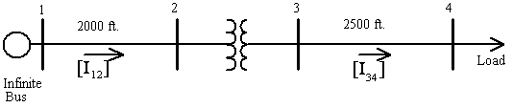
Feeder Example
IEEE 4 Node Feeder
Presented as a system of nodes and links
Use FBS and NR method to solve
Compare the solutions

Slide 68
Powerflow Output
3-ph voltage at each node, including inherited objects
Power/current in/out
Each phase
Each link,
Includes inherited objects
Additional information available for specific objects,
Tap positions
Switch states
Log of events
Output to KML if specified

Slide 69
Sample Static Powerflow Output
Load object: (node)
Transformer object: (link)
Name | constant_power_A | constant_power_B | constant_power_C | voltage_A | voltage_B | voltage_C
(load_11) (#11) | 1.8e+006+871780j W | 1.8e+006+871780j W | 1.8e+006+871780j W | 1918.94-271.698j V | -1266.24-1576.4j V | -697.555+1873.95j V
Name | configuration | status | From | to | power_in | power_out | phases
(transformer_8) (#8) | transformer_config_4 | CLOSED | node7 | node9 | +7.17672e+006 W | +6.81855e+006 W | ABCD

Slide 70
Time-Series Powerflow Output
Time-series gives a solution for each time step
Series of .xml files is not practical:
1 year at 1 minute resolution yields 525,600 solutions
Use recorders to output desired values to .csv files.
These can then be post processed or plotted.

Slide 71
Exercise 4.1
Load one IEEE 4-node test feeder, run it, and examine the output file.
Run the feeder with different transformer configurations and note the effects.

Slide 72
Exercise 4.2
Load the IEEE 37-node test feeder, which will be used in other exercises.
There is a missing line. Find the missing line and fix the model to include the line.
Replace this line with a Delta-Delta transformer.
Connect an additional load via a node-to-node connection (e.g., without a link object).

Slide 73
Exercise 4.3
Load the IEEE 13-node test feeder, with building loads already attached.
Examine the interface between the powerflow module and the residential module at the triplex meter objects.

